Slide 2
Mood Boards for Web Design

Slide 3
What is a Mood board?
A type of collage that may consist of images, text, and samples of objects in a composition of the choice of the mood board creator.
Designers and others use mood boards to develop their design concepts and to communicate to other members of the design team.

Slide 4
Mood boards
Convey Feeling
Generate Discussion
Maintain Focus

Slide 5
Mood boards can be
Physical
Digital
Loose Collage
Refined
.

Slide 6
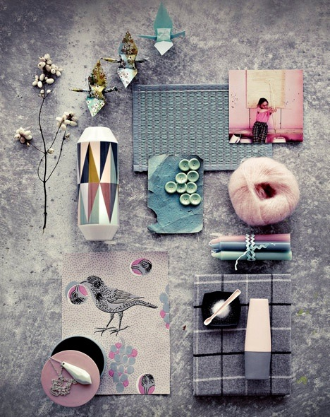
Physical
Using objects and textiles to convey colour, texture, mood

Slide 7
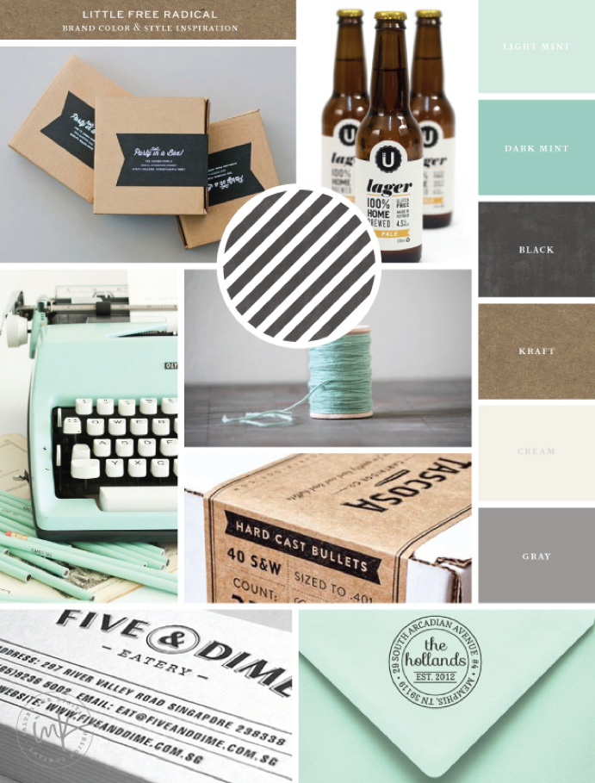
Digital
Using images and colour swatches in digital form to convey colour, texture, mood

Slide 8
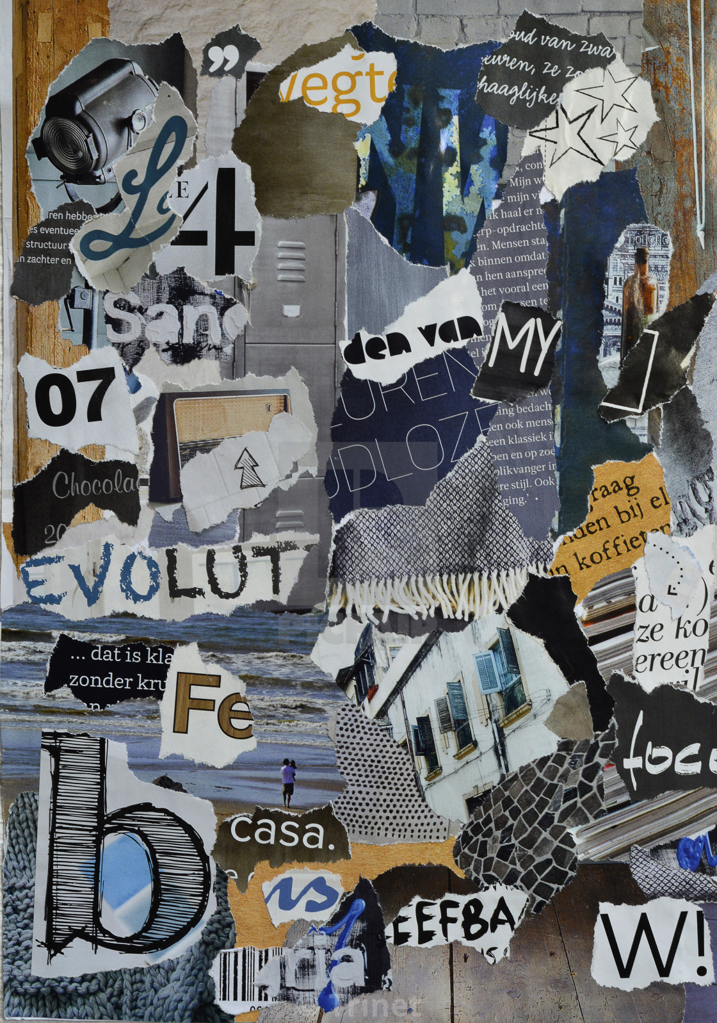
Loose Collage
Doesn’t go into the detail – is used to convey the big picture look and feel you are going for
Objects and images of different size
Free alignment
Free orientation

Slide 9
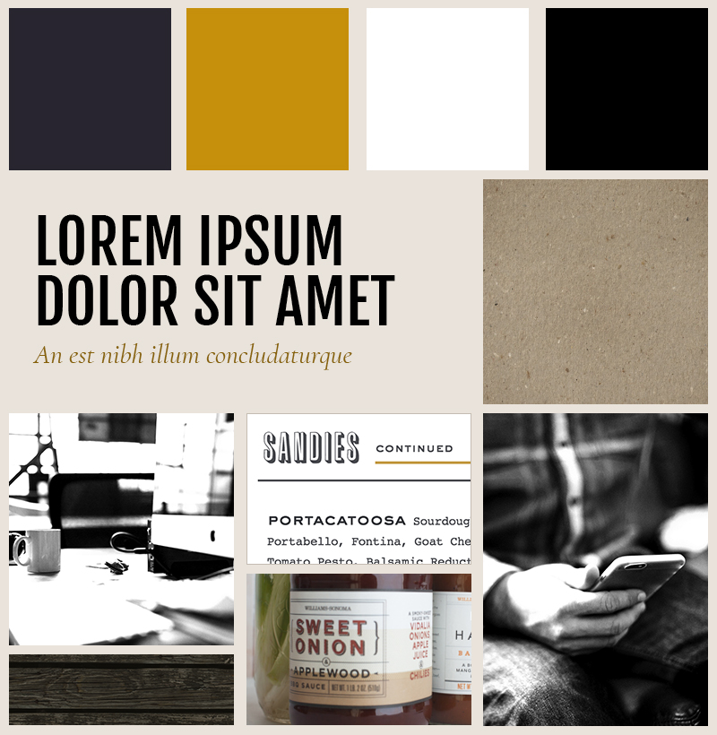
Refined Template
Conveys the detail
Organised
Clear individual elements
Details colour palettes and fonts

Slide 10
Mood boards do not Communicate
The design of a specific page template
Final content (headlines, body text, image selections)
Final site hierarchy & user navigation

Slide 11
How does the Mood Boards fit in to the overall Web Design process?

Slide 12

Step 1:
Meet the Client
Understand the company values, and vision
Review their available assets (literature, photography, promotional materials, etc.)
Agree critical functionality and customer objectives

Slide 13
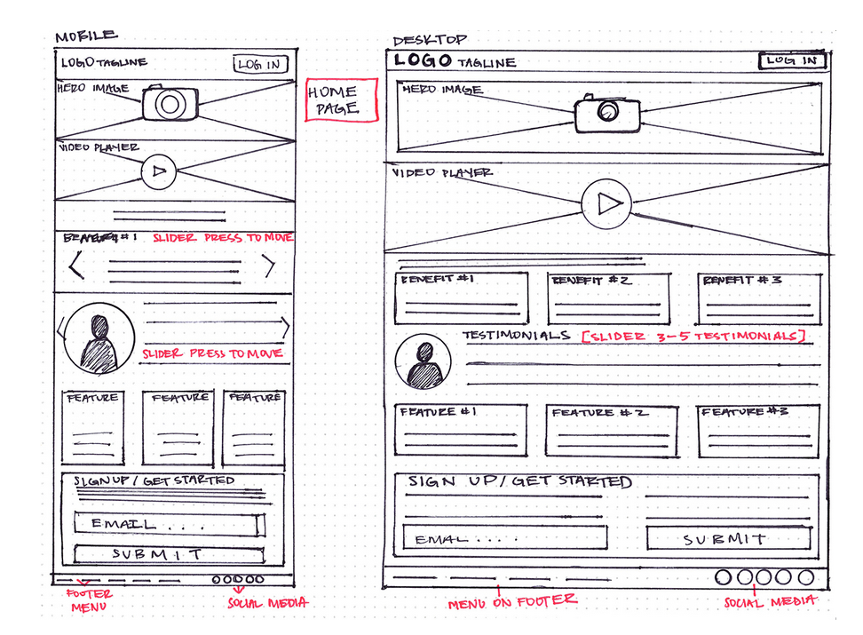
STEP 2: Wireframes
Skeleton Page Layouts
Like “stick-figure” people, they're simple visual representations of complex concepts
Covers all pages
Gain Approval

Slide 14
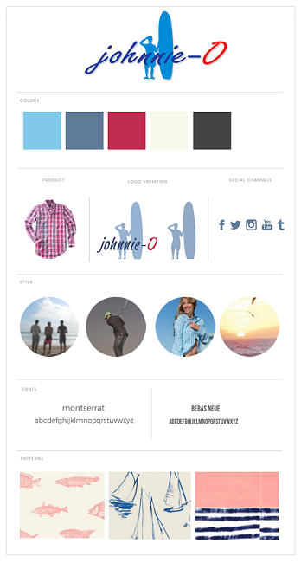
STEP 3: Mood Board
Define:
Colours
Textures
Photograph style
Fonts
Icons
Character

Slide 15
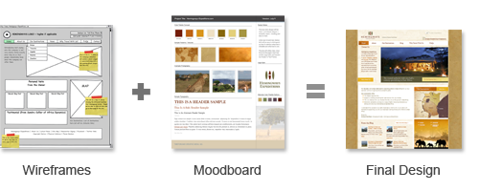
STEP 4:
Designing the website
Take the skeleton layout of the wireframe, dress it with the textures and colours from the moodboard, and translate it all into a final design

Slide 16
Recap
Mood boards are great for conveying a concept
Web Design mood boards identify key visual attributes of a web site
Mood boards are only part of the overall web design process

Slide 17
